Slide 2
Behavior Changes
Sr. Jacqueline Nedd, BSN, RN, RSM
January 28th 2024

Slide 3
Introduction
January is the beginning of the New Year, and we hope that you would find the material on Behavior Change helpful in achieving your goals, and or New Years resolutions. It would be good to journal or take notes of anything you think would help you over come the challenges of achieving your dreams. Changes are self-care actions, activity, or processes we can apply for the well-being of our journey.
So, think of one thing that you would like to change in 2024.
Our Goals for the New Year need to be achievable, realistic, and one that we could stick to.
One example of a long-term, achievable goal for me is creating a to-do list and reading it frequently to keep on track. (:>)
Another goal, a short-term goal I have is to make this presentation simple, and easy for you to apply to any change you hope to make in your future.

Slide 4
Behavior
Definition
Behavior is something that a person does, such as an action, activity, or process which can be observed and measured. Often, these actions, activities, and processes are initiated in response to stimuli which are either internal or external. Psychologist Gary Man. (By N., Sam M.S.)

Slide 5
Human Behavior
Definition
Human behaviors are the general patterns of the behaviors of humans. Human Behavior refers to the full range of physical and emotional behaviors that humans engage in; biologically, socially, intellectually, etc. and are influenced by culture, attitudes, emotions, values, ethics, authority, rapport, persuasion, coercion and/or genetics.

Slide 6
Change
Behavioral Change
Human behavior is influenced by several factors including genetics and the environment. Behavioral change is about altering habits and behaviors for the long term.
Most research around health-related behaviors (Davis, Campbell, Hildon, Hobbs, & Michie, 2015) indicates that small changes can lead to enormous improvements in people’s health and life expectancy. These changes can have knock-on effects on the health of others (Swann et al., 2010).

Slide 7
Behavior Changes
Some Examples of Health Changes include:
Smoking cessation
Reducing alcohol intake
Eating healthily
Exercising regularly
Practicing safe sex
Driving safely

Slide 8
Behavior Changes
Other behaviors that are the target of change interventions are those affecting the environment, for example:
Littering
Leaving lights on
Not recycling
Overuse of water

Slide 9
Behavior Changes
Some behavior changes may be related to improving wellbeing, such as:
Reducing procrastination
Incorporating regular self-care activities
Being more assertive at work
Going to bed earlier
Practicing mindfulness
These examples of behavior changes might have been tried at some time in our lives and
while some changes may be easy, others may have proven quite challenging.

Slide 10
How long does it take to change a behavior?
It takes 21 days to form a new habit. True or false?
Myth:
The answer is: No. This is myth. It does not take 21 days to form a habit. It is a
misconception of Dr. Maxwell Maltz’s work on self-image; who did not find that it takes 21
days to complete a task and form a habit, but people wanted to believe it.
The duration to form a habit varies from 18-254 days, or an average 66 days.
It is unfortunate that the 21 days myth is believed by many people who become
disappointed when it doesn’t work.

Slide 11
The answer to forming a desired habit or behavior and
the duration depends on:
The type of person you are. Since everyone is different it will depend on how well you handle disappointment when a habit isn’t; formed as quickly as you hope it would.
The type of habit you want to form.

Slide 12
Habits
Tom Bartow divided the process of forming a new habit into 3 phases:
It is easier and more reliable than numbers of days. Audio Book)
Research done by the University College of London shows that is takes anywhere from a 118 day to days or an average of 66 days form a new habit.

Slide 13
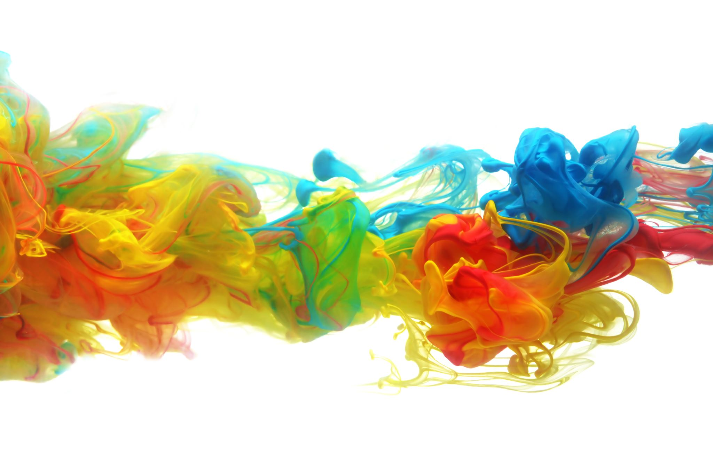
Stages of Change Model

Slide 14
The Six stages of Change

Slide 15
Six Stages of Change
1-Pre-Contemplation
You have no intention of changing your behavior:
The individual is not aware of the problem, is in denial, and is not seriously thinking of changing the behavior. They may have made several attempts before and given up.
2-Contemplation
You are aware that there is a problem, but you have no action plan:
The individual is ambivalent about changing their behavior. They can see reasons to change but is still hesitant. The behavioral problem remains.

Slide 16
Six Stages of Change
3-Preparation
You have every intention of acting to change your behavior:
The individual has decided to change their behavior and began to think of how to do so. They will begin to make minor changes to support their goal but might not have completely ended the unwanted behavior.
4-Action
You act to modify your behavior:
The individual makes significant changes to end their unwanted behavior by avoiding triggers, reaching out for help or taking steps to end the behavior.

Slide 17
Six Stages of Change, continue
5-Maintenance
You continue to maintain the change you made. The New Behavior replaces the old behavior: The changes the individual made during the action stage are maintained. The individual may continue to face challenges, but they have consistently changed their behavior for a significant period – of - time.
6- Relapse
You fall back into old habit/patterns of behavior:
Some individuals relapse by returning to their old behavior/habits. This can happen any time during the previous stages. Not everyone will experience a relapse, but it is a risk.

Slide 18
The Importance of Creating Habits and Routine
What is the difference between a habit and routine?
How are habits formed?
How do we adopt a beneficial habit?
A habit is an automatic urge or an impulse to do something, often triggered by a desire, or a cue. Repetition forms a habit.

Slide 19
Routines vs. Habits
A routine is a behavior that requires deliberate conscious thought.
Routines are structured and organized.
When we follow routines, a habit is formed.
However, routines take time to establish.
A habit is an automatic urge or impulse to do something often triggered by a particular cue.
As a child we learn the skill of washing our hands before eating, or before, and after using the bathroom. The constant repetition of step-by- step technique of turning on the water, wetting and lathering hands with dispensed soap, rinsing and, drying hands is automatically done as an adult.

Slide 20
How do we adopt a beneficial habit? Hand Washing
Frequent Hand Washing is a repetitive action that becomes a habit.
Making a lasting change in a behavior is never a simple process.
It usually involves a substantial amount of time, effort and emotion.

Slide 21
Habit Loop
How and why are Habits formed?
Habits are formed by a concept called Habit Loop. The Habit Loop has three main cycle/components, the Cue, Routine, and Reward.
CUE: The first component/cycle is the cue or trigger that tells the brain to go into automatic mode to let a behavior unfold. For example, we need a cue or a reminder such as a note or an alarm clock to tell us when to wash our hands or take a daily vitamin/medication starting a habitual behavior.
Cue prompts routine behavior determined by the place, time, emotional state, people, and last action.

Slide 22
Habit Loop
The Routine: The second cycle/component is the routine, which is the repetitive behavior or habit.
We take our vitamins or medication when we hear the alarm clock or read the note. Over time this routine behavior becomes automatic like washing our hands.

Slide 23
Habit Loop
The third cycle is the reward.
The Reward: Scientists found that positive reinforcement is necessary to learn new habits. The reward in this scenario is the satisfaction of doing something good for your body when you take your vitamins or washing your hands remaining free of germs.
Rewards reinforces routines and forms habits.

Slide 24
Breaking Habits
Breaking habits are not easy, but change is possible.
Identify the Routine: Duhigg recommends that you recognize the routine behavior that you want to break.
Your routine might be turning off the alarm multiple times and forgetting to take your vitamins/medication.
Putting off taking your vitamins/medication may results in your body not feeling well or rewarded.
A lack of positive rewards may result in a desire to break a habit. This desire to feel rewarded leads us to respond to the alarm clock and take vitamin/medication so our body feels better.

Slide 25
Adopting Habits
Knowing your Habit Loop (cues / triggers, routine, reward) can help you to develop a plan for adopting a habit.
Your reward for responding by taking your vitamin/medication when the alarm clock goes off or when you see the reminder note is your body feeling well.
A new habit is formed over time with repetition. Start with small and set achievable goals that will make you more likely to succeed. For example, if you have a daily meal routine, plan to take your vitamins/medication with meals.

Slide 26
Adopting a New Habit
Building a new habit is training your brain to do something automatically.
The habit loop method may take trial and error may and may not work for you.
Remember a routine behavior takes time to develop. It may take approximately 18-254 days depending on the habit, according to the University of college of London study.
You may reward yourself when you succeed at forming a new habit such as starting a new exercise program or diet.
Knowing your habit loop may help you to form new positive routine.

Slide 27
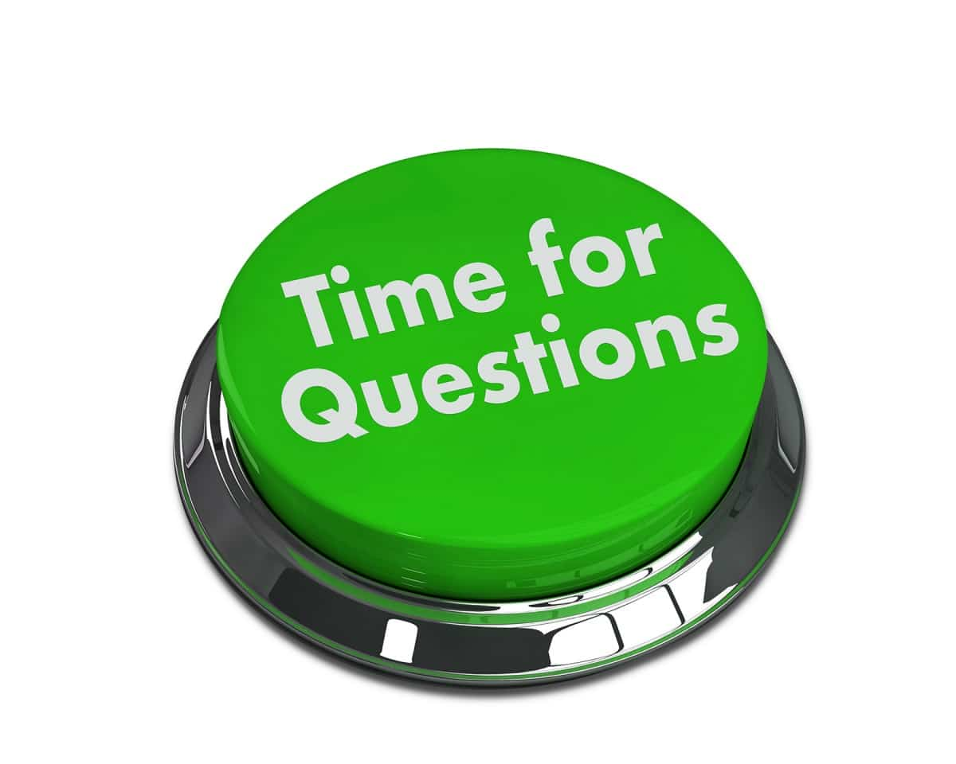
Questions
The time for Questions and Answers will come after Sr. Chero’s presentation.
This Photo by Unknown Author is licensed under CC BY-NC-ND

Slide 29
Citation
Coaching: An International Journal of Theory, Research
and Practice, 1 ( 2 ), 145 – 63.
Wolpe , J. and Lazarus , A.A. ( 1966 ) Behavior Therapy
Techniques.
Behavior Change. Positive psychology.com
Journalist Charles Duhigg introduces the concept of the
habit loop in “The Power of Habit: Why We Do What We Do in Life and Business.”
Current Version, Feb 5, 2021, Edited By Kelly Morrell
Medically Reviewed By Marney A. White, PhD, MS Copy
Edited By Sara Giusti
Wolpe, J. (1973 ) The Practice of Behavior Therapy. New
York: Pergamon.
Wolpe , J. ( 1973 ) The Practice of Behavior Therapy .
New York : Pergamon.

Slide 30
Citation, continue
New York. NPR.org Ritual.com
Spence, G.B., Cavanagh , M.J., and Grant, A.M. ( 2008 ) The integration of mindfulness
training and health coaching: An exploratory study.
Study.com.acadmy/lessons. What is human behavior. Definition. Quiz.html
Strayer , J. and Rossett, A. ( 1994 ) Coaching sales performance: A case study.
https://study.com/academy/lesson/what-is-human-behavior-definition-lesson-quiz.html.
Psychology dictionary professional reference. https://psychologydictionary.org/behavior/
WELLNESS Image. POST BY: Welness/ONLINE MINDFUL THERAPY / MAY 14, 2020 https://www.onlinemindfultherapy.com/wellness/
www.forbes.com › sites › jasonselkHabit Formation: The 21-Day Myth - Forbes

